Slide 1
ETIM Product Classification Masterclass
The essence of product data standards
Notes:
Welcome to this webinar.
My name is Jeroen van der Holst, the community director for ETIM International. ETIM has played a part in my career since the late 90’s. I am here together with Marc Habets our technical director who will be assisting with the lobby and chatbox.

Slide 2
Program
Short introduction of ETIM International.
The essence of product data exchange.
Product classification.
Typical use cases.
Governance.
Questions from the chat.
Notes:
This webinar is the start of a series of webinars we’d like to organize from time to time.
We are with a large number of participants in the meeting room. To keep things manageable, we have muted all your microphones and we advise you to keep your cameras off. Today we start with the fundamental basics:
A short introduction of ETIM International and the ETIM standards
The essence of product data exchange
Product classification and what it means to have
Typical use cases
Governance
Questions can be posted in the chat, and we will save them for after the presentation.
We will try to stay away from complicated technical terminology.

Slide 3
What is ETIM
A set of open standards, managed by the ETIM Community:
Classification standard for technical products (“The ETIM model”).
Product Data Exchange standard (“ETIM xChange”).
Classification standard for geometric data (“ETIM Modelling Classes”).
Active in 5 sectors.
Electrotechnical supplies
HVAC, plumbing and sanitary
Building materials
Hardware, tools and site supplies
Shipbuilding
Notes:
What is ETIM?
ETIM is a set of open standards that are managed by its users.
A classification standard for technical products.
A standard that describes a file format for exchanging product data.
And a classification standard extension for geometric data.
We are active in 5 sectors that evolve around construction and installation.

Slide 4
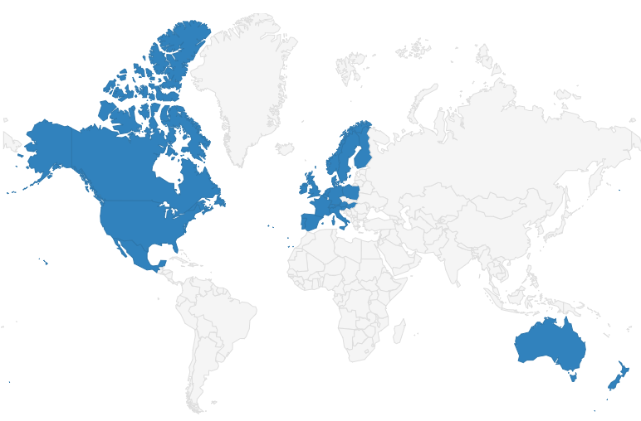
ETIM Technical Information Model
Product Classification (taxonomy) for digitally exchanging product data.
5.640 classes.
17.377 features.
5 technical sectors.
Represented in 21 countries.
35 years of experience
Notes:
We have chapter organisations that represent these sectors in around 23 countries.
It took us over 35 years to build this database and the network of organisations supporting this.
Product classification is nothing more than a taxonomy, which is similar to categorizing the animal world or library books.
We have now come to describe over 5640 product families,
Using over 17000 individual feature descriptions

Slide 5
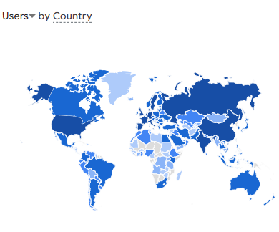
Used globally
Across ~150 countries
By over 44K individual experts
Backed by over 50 Industry and Trade associations.
Uncountable number of software applications: ERP, MDM, PIM, eCommerce, BIM, planning, procurement …
Notes:
Last time we checked our Google analytics pages
we saw over 44.000 individual experts from around 150 countries
Actively consulting our data model
We are actively collaborating with over 50 Industry and trade associations.
Our standards have been implemented in hundreds of applications and platforms

Slide 6





1991
1999
2006
2009
2010
2012
2014
2015
2017
2019
2020
2021
2025
1991
2005
2008
2011
2015
2018
2020
2023
Start of project: Elektro Technisch Informatie Model
ETIM 3.0 NL,DE,EN BMEcat
European Technical Information Model
Idea in NL: ETIM MC
Project ETIM MC by DutchIndustry
ETIM MC handed over to
ETIM Int.
Global
Industry
Membership
Birth of ETIM xChange + Funding for ETIM MC
Notes:
ETIM has been around for a while. The initiative started as a project of an installers’ association in the Netherlands in 1991.
It took 15 years to become internationally active starting with 6 countries.
But that number tripled in the second 15 years.
In the last 5 years ETIM International has expanded its operations to support ETIM xChange and ETIM Modelling Classes as complementary standards.

Slide 7
The Essence of Product Data Exchange
Notes:
No that we have introduced ourselves properly, you might think: “So what???”
Why are you making such a fuzz about standardizing the exchange of product data?
What is it that cannot be solved with diligent and clever use of Office 365?
That is what I would like to explain right now

Slide 8





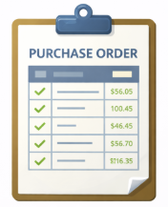







Supply chain processes in construction
1. Product information
2. Purchase
Manufacturer
Wholesaler
Contractor
Engineer
Architect
Owner
3. Delivery
4. Payment
Notes:
Let’s start by explaining what place product data exchange has in the supply chain.
(click)
If you want to be a profitable participant in the wholesale construction supply chain.
(click) you would like to move a lot of product.
(click )
And for this to happen you would need to persuade your customers.. to send in purchase orders that originate from the constructional and engineering designs
(click) But here is the catch: People can only order the right product once they have your product information to choose from. And just a description and price is not enough. Technical features need to match with the technical requirements as specified by the contractors, engineers and architects.

Slide 9


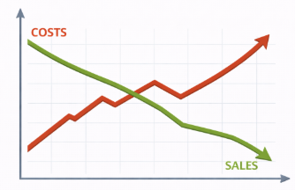
The essence of Product Information Management
Planning construction takes multiple years
Trends in product development
Product diversification increases
Rapid time to market
Poor quality of product information leads to
Wrong product, wrong place, wrong time
Failure costs, Credit notes
Additional work
Liability, damages
Bad sales figures
GOOD QUALITY PRODUCT DATA
Notes:
There are some conflicting trends we need to take a look at.
(click)
Planning of a construction project is getting more detailed, but it takes multiple years until all contracts are signed and permits have been granted
(click)
On the other hand, Research and Development departments are significantly speeding up their time to market
while product diversification goes into next levels
(click)
This abundance of choice needs to be managed. That is why the demand for high quality product data is booming.
We have come to realize that..
Poor quality product data results in failure costs, credit notes and liability claims, projects stalling, additional work and above all .. Bad sales and profit figures
(click)
Good quality product data can boost your sales and profitability.

Slide 10
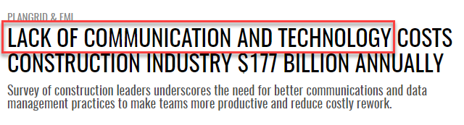
The KPI’s no one considers, while everyone should
The % of negative sales in credit notes.
Costs of return shipments.
Costs of additional work.
Liability claims.
Hours spent by customer service on fixing problems instead of helping to increase sales.
Notes:
Let me explain further:
There are some key performance indicators that are often overlooked.
Because they are hard to measure
Because they deal with negative experiences
But these indicators can mean the world for your sales and profit figures
(click)
How much sales value is credited at the end of the month? What if you could cut that number in half?
(click)
How much does it cost to process a return shipment? And what is the impact on the environment?
(click)
What are the costs of additional work on construction sites to fix work that has to be replaced or redone using the right products?
(click)
What is the value of settlements with customers to manage the relationship, or because of legal consequences?
(click)
What is the value of the hours spent by customer service employees making apologies and trying to fix problems, while they could be doing activities that could help increase sales figures.
(Click)
If you look for surveys on failure costs in construction, they all show significant savings potential and the same root cause: a lack of communication and data management practices

Slide 11


Product data exchange, no standards
M
M
M
M
M
M
M
M
W
W
W
W
W
W
W
Interpret
Convert
Edit
Research
Validate with supplier
C
C
C
C
C
C
Housing Corporation Home / Building owner
Notes:
Lets continue our analysis:
In this slide I have set up a very simplified business chain of a couple of manufacturers, wholesalers and contractors,
doing work for housing corporations or building owners.
The contractors needs digital product information for their procurement and work planning, the wholesalers need product data for their ERP systems and ecommerce platforms.
The manufacturers try to keep up with all demand for information.
If all try to share information by flexing their Office 365 skills,
Everyone needs to process different file structures and formats for each interaction within the business chain.
But also..
There is no guarantee what soever in terms of validity of the information.
Are products still available?
Are the products still technically compatible for my system or building?
Data managers end up converting, editing, manually entering data
And constantly need to consult suppliers to fact-check technical features This situation is setting us up for failure cost and inefficient work
And the manufacturer has no control over the product information that is used further up the chain.

Slide 12
Product classification
Core concepts
Notes:
But people there is hope… Let us dive in to product classification’s core concepts

Slide 13

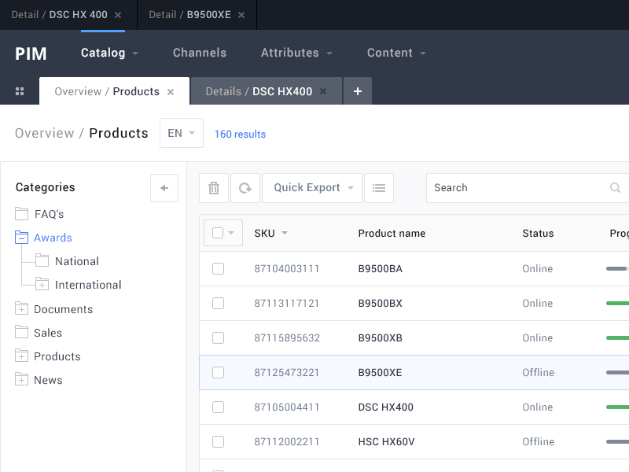

ETIM product classification is…
Data base
Software
Product content
a standard structure and format to exchange product data
Notes:
First of all let us get this straight. (click)
ETIM is not a database (click)
We are not trying to sell you software (click)
And we don’t have any product information (Click)
We are just the standard.. A standard structure and format to digitalize and automate the exchange of product data
We are the playbook.
We are an open standard, and it is up to the market to use it in day to day business. We will explain later how that is done.

Slide 14

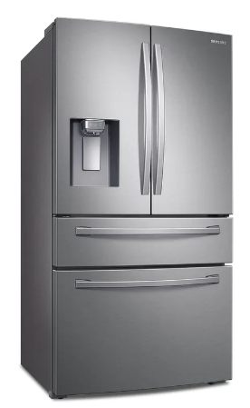
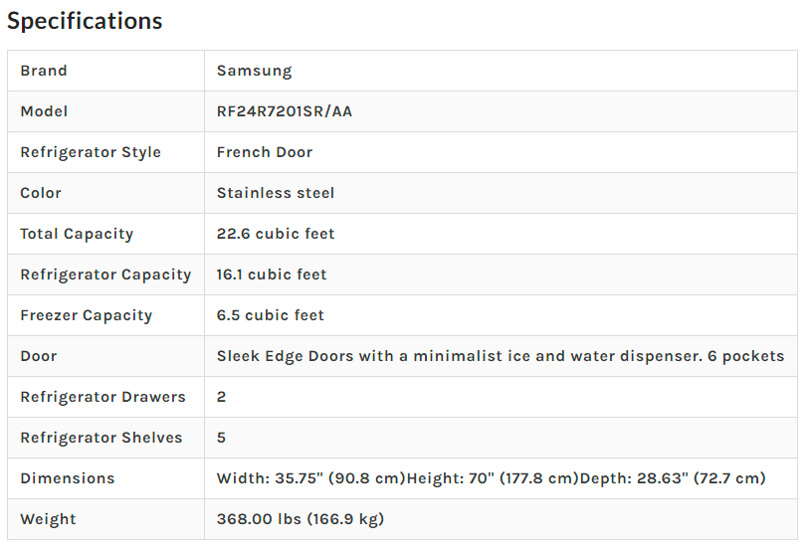
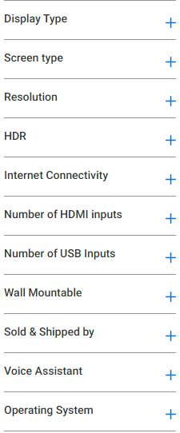
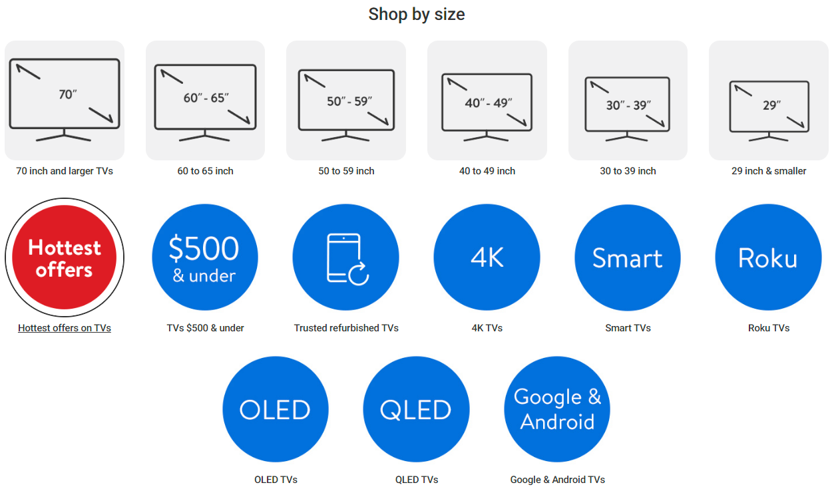
A TV is not a refrigerator
Notes:
So let’s talk about product classification. Classification is no rocketscience, it’s not new either.
It is easy to explain. We all know that a TV is not a refrigerator. They are different products.
And you will need other features to pick the right TV or refrigerator. Anybody can create a taxonomy on their own. But here’s the catch: If you have a business that sells TVs and refrigerators from 20 different brands.
How will you make sure you get all their product features aligned perfectly into your ERP system or Website? Or if you are a manufacturer that sells to 20 different wholesalers. How will manufacturers be able to use one product data file for all wholesalers, saving a ton of work? You will need some form of standardisation

Slide 15
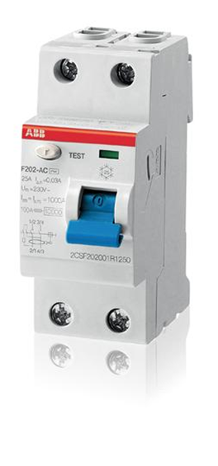
Products and features, no standards
“Brand A” | Compatibility | Brand “B”
Earth leakage circuit breaker (ELCB) |  | Ground Fault Circuit Interrupter (GFCI)
Short-circuit breaking capacity 0,63 kA |  | Rated fault breaking capacity 630 Ampère
IP class IP 20 |  | Water protection FALSE
Mounting depth 73,5 mm |  | Installation depth 0,29 Inch
Two technically similar products, with three similar technical characteristics, could appear like two completely different products.
Notes:
When it comes to technical products, classification is even more serious business.
You cannot do without standards.
Let me show you by example.
Let’s assume you need to buy one of these products and you can choose between brand A or brand B
This product can be called many things:
Earth leakage circuit breaker (ELCB) is an older terminology
Ground Fault Circuit Interrupter (GFCI) is the official name according to UL standards
Residual Current Circuit Breaker (RCCB) is the official name according to IEC standards.
Both brands use different names.
Then you’ll need to figure out if both products are technically fit for your requirements
You see that Brand A uses different names, units and data types to describe similar characteristics as Brand B
This is causing confusion. Two technically similar products, with three similar technical characteristics, could appear like two completely different products

Slide 16

Products and features, no standards
“Brand A” | Compatibility | Brand “B”
Sand-lime brick |  | Calcium-silicate stone
Length = 10 Inches (Length x width x height) |  | Width = 254 mm (Width x Depth x Height)
Water Absorption (EN772-21) 1% |  | Water absorption (BRL 1007) IW2
Compressive strength (ASTM C73) 2900 psi |  | Compressive strength (EN 771-2) CS20
Two technically similar products, with three similar technical characteristics, could appear like two completely different products.
Notes:
You might think: I have nothing to do with electrotechnical stuff….
I work in HVAC or construction..
However… the same symptoms can be found in many different products.

Slide 17
ETIM Classification
Standardised product classes with features, units and values.
Everything is coded and provided with translated descriptions.
Data is exchanged and stored as a collection of codes with values
Notes:
Now what ETIM product classification does, is
It provides a clear structure of standardized product classes
Product family names are given an official name, with a list of synonyms tied to that class name
Each class provides a standard set of features, units of measurement and optional values
And every class, feature, value and unit has its own digital ID and it is tied to translations in several languages.
This makes our classification data machine readable and language independent.

Slide 18
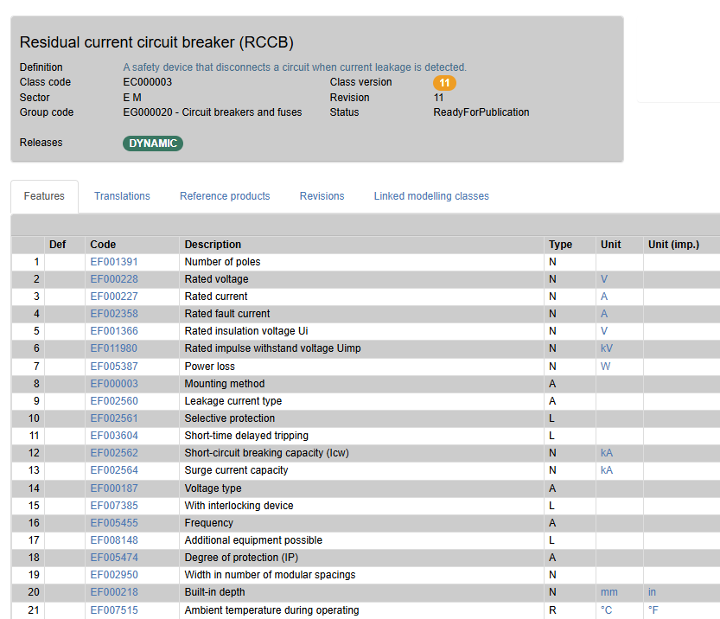
Notes:
This is what it looks like on our website. Now you have a “service contract” that dictates the level of information that is expected to be supplied with these products.
It is a consensus reached within our community of suppliers, wholesalers and contactors. I will explain later how this process works.
As you can see the product class and its features all have been given an ID nr.

Slide 19
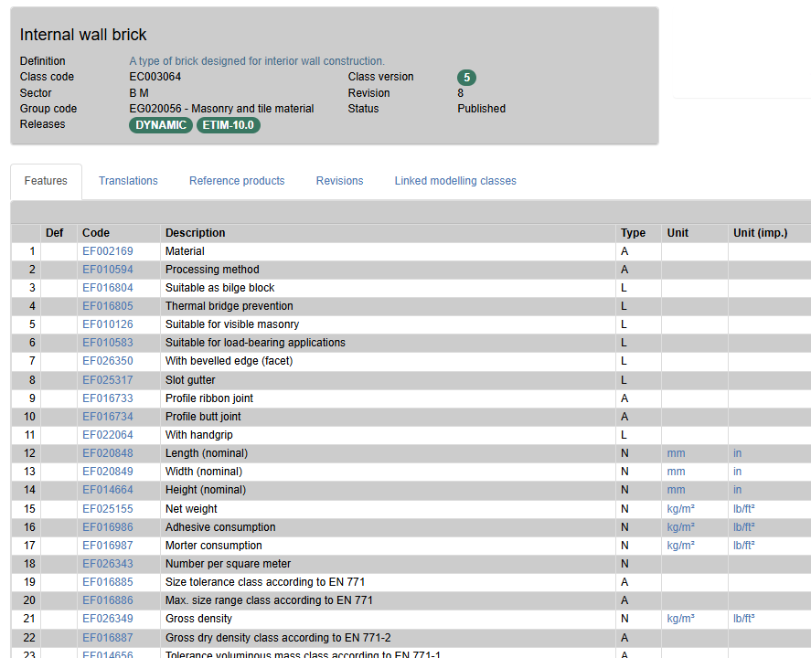
Notes:
The same applies to products of any other sector.

Slide 20
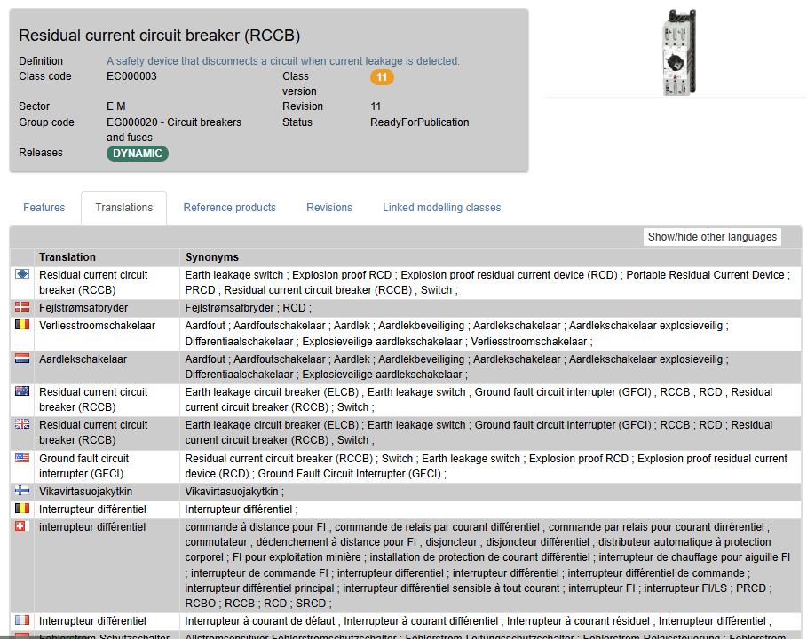
Notes:
And tied to the ID nr of that class, a complete list of translations and synonyms are being maintained by our community.

Slide 21

Preferred terminology for class EC000003
Language | Class name | Synonyms
English (UK) | Residual Current Circuit Breaker (RCCB) | Earth leakage circuit breaker (ELCB); Ground Fault Circuit Interrupter (GFCI); Earth leakage switch
English (US) | Ground Fault Circuit Interrupter (GFCI) | Ground Fault Circuit Interrupter (GFCI); Earth leakage circuit breaker (ELCB); Earth leakage switch
French | Interrupteur différentiel | Commande de relais par courant différentiel; Interupteur de commande FI; Interrupteur FI/LS
Spanish | Interruptor automático de corriente residual (RCCB) | Control de relé por corriente diferencia; Dispositivo diferencial residual; Disyuntor diferencial
ETIM Classification is language independent,
enabling data sharing across borders!
Notes:
In the class definition you can choose the right name in each language, while the alternative names can be stored as synonyms. The computer only needs ID codes to understand. This translation work is done by native speakers from the industry.

Slide 22
ETIM Classification data
ETIM Classification |  | “Brand A” values
Product desciption | - | MyBrand Earth leakage circuit breaker (ELCB)
Product class | EC000003 | -
Short-circuit breaking capacity (Icw) in kA | EF002562 | 0.63
Degree of protection (IP code) | EF005474 | EV006405 – IP20
Built-in depth in mm/inch | EF000218 EFI00218 | 73.5 0.29
ETIM Classification data is machine readable,
But can be converted back into any human language
Notes:
Now if we would classify this product according to ETIM classification, the data ready to share would look something like this: A sequence of ID numbers with values.

Slide 23
Products and features, ETIM Classification
ETIM Classification | “Brand A” | Compatibility | Brand “B”
Product class EC000003 | Residual Current Circuit Breaker (RCCB) |  | Residual Current Circuit Breaker (RCCB)
Product desciption | MyBrand Earth leakage circuit breaker (ELCB) |  | Ground Fault Circuit Interrupter (GFCI)
Short-circuit breaking capacity (Icw) in kA | 0.63 kA |  | 0.63 kA
Degree of protection (IP code) | IP20 |  | IP20
Built-in depth in mm/inch | 73.5 / 0.29 |  | 73.5 / 0.29
Two technically identical products, Three exactly identical technical characteristics, Technical compatibility verifiable!
Notes:
ETIM classification provides clarity in finding and choosing the right product
It also brings a lot of opportunies for automation and analysis.

Slide 24
Products and features, ETIM Classification
ETIM Classification | “Brand A” | Compatibility | Brand “B”
Product class EC003064 | Internal wall brick |  | Internal wall brick
Product description | Sand lime brick |  | Calcium-silicate stone
Width (EN 772-16) in mm/inch | 254 / 10 |  | 254 / 10
Water absorption (EN-772-21) | 1% |  | 1%
Compressive strength (EN 772-2) | CS20 |  | CS20
Two technically identical products, Three exactly identical technical characteristics, Technical compatibility verifiable!
Notes:
And again… it works for all technical industries.(click and pause)

Slide 25
Use Cases
Notes:
Let’s have a look at some of the use cases in practice.

Slide 26
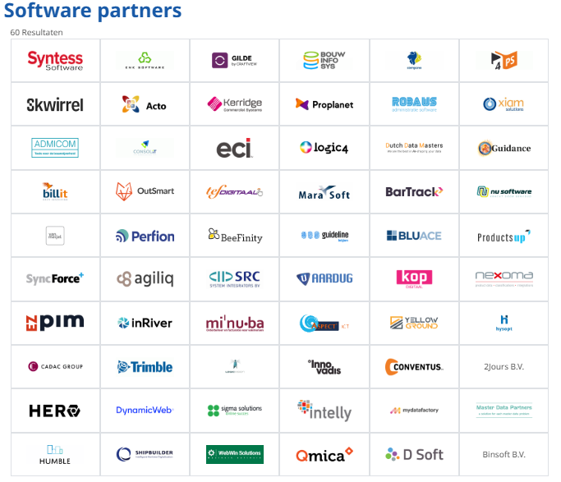
Standards enable Off-the-shelf Software
Because file format and data structure is standardized, off-the-shelf software can integrate ETIM data into their solutions:
Master Data Management (MDM)
Product Information Management (PIM)
Ecommerce Platforms (CMS)
Enterprise Requirement Planning (ERP)
Building Information Modelling (BIM)
Notes:
First important thing to explain is…
Digitalization is built on the fundament of standardization.
Because file format and data structure is standardized,
off-the-shelf software can integrate ETIM data into their solutions

Slide 27
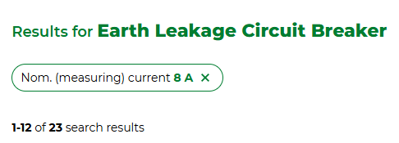
Automated uploads and search optimization
2.4 million products !????
Wholesalers need:
Standardized file formats for automation of product data uploads.
Standardized structure for search filters.
Synonyms to serve as search key-words.
Notes:
If you would like to buy something at any wholesaler of HVAC and electrical products these days,
you easily start with a choice of over 2 million products.. (click)
In order to simplify the buying process for their customers, wholesalers need:
Classification data to power their search engines.
Standardized file formats for automation of the product data uploads.

Slide 28
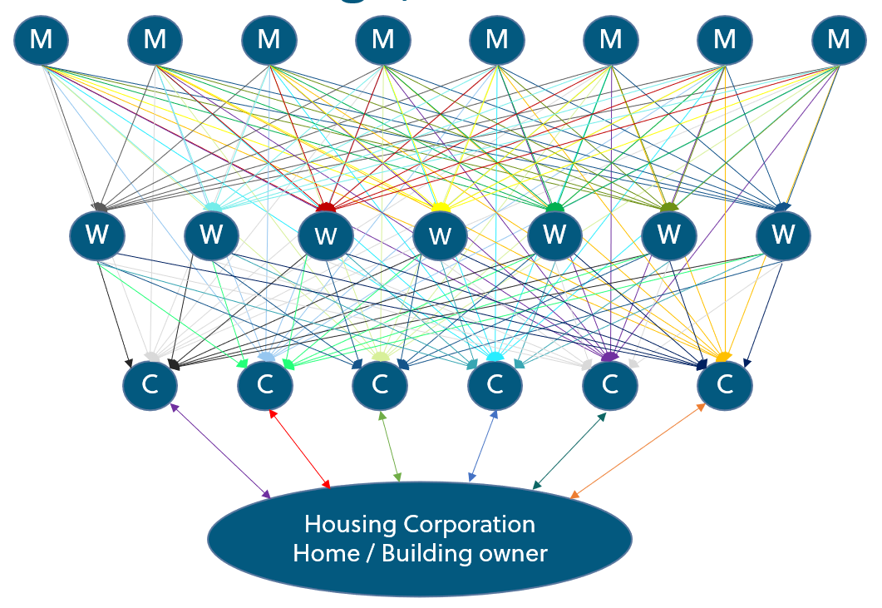


Datapooling
Datapooling: Only 1 upload, only 1 download
Single source of truth (the manufacturer).
Query the entire range of a country.
M
M
M
M
M
M
M
M
Central Datapool
W
W
W
W
W
W
W
C
C
C
C
C
C
Notes:
Remember the messy data exchange I described earlier? Data pools regulate the flow of data from a single source of truth which is the manufacturer
They also provide additional services for safeguarding and improving data quality
And they allow you to search on all products that are on the market
In many countries we see that industry and trade associations invest in not for profit centralized data pools based on ETIM.
We list several of them on our website.
But there are also commercial initiatives that provide data syndication based on ETIM
and a large wholesaler’s ecommerce platform could also be considered as a data pool.

Slide 29

Classification in the customer journey
Technical specifications
Filter on technical properties
Shortlist
Brand preference
Purchase
ETIM Standards get you on the shortlist!
Brand preference
Perceived quality
Perceived value for money
Delivery reliability
Positive customer engagement experiences
Good quality Product data
Notes:
Right about now is when some of you might think that
classification data allows to compare your premium
quality product with cheap low quality alternatives.
Like comparing apples with oranges..
Well I can tell from experience..
(click)
That is not how the customer journey works when buying technical products.
A customer first needs to find products that meet the technical requirements from a large pool of products.
They need to be able to filter on product types and technical features.
They build a short list with products that qualify, that are technically compatible
(click)
ETIM helps streamline that part of the customer journey. (click)
From then on it is brand preference that matters
Perceived quality, value for money, delivery reliability….
The sum of all positive customer engagement experiences push towards a buying decision
ETIM is not taking anything away from that.
But showing good quality product data is a positive customer engagement experience.

Slide 30
Business Intelligence
Order lines
Linking order lines to ETIM structures using the product identification codes like GTIN:
Cross sections on classes or features.
Examples:
Turnover of products with specific technical approval.
Turnover of products from a certain type of material.
Regional sales of certain product types.
Across multiple businesses in a multinational.
Product Identification
ETIM class ETIM features
Notes:
And with ETIM classified product data you can do so much more
Like creating Business Intelligence cross-sections in your sales data.
Creating a profile based on a filter built on a collection of ETIM classes and specific feature settings.

Slide 31
Procurement optimization analysis
Suppliers
Connect ETIM classes and features to buying-orders.
Look for optimizations of the procurement process:
Similar products bought from multiple manufacturers
Same products bought at multiple suppliers
Optimize to max. 2 brands
Optimize to 2-3 suppliers
Analyse business volumes
Re-negotiate with preferred suppliers
Buying Order lines
Product Identification
ETIM class ETIM features
Notes:
You could analyze your procurement strategy
By making cross sections on product types based on ETIM codes
Check the number of suppliers
Bring it back down to only one primary source and a second source
Consolidate buying volumes that can be used to renegotiate prices

Slide 32
Price and discount management
Standard Discounts
Discount rules in ERP and Ecommerce systems, often are based on custom classifications or discount groupings.
These can be ambiguous, as these are unknown to the discount-receiving party.
ETIM Classes can be used as Discount group identifier, which brings clarity to everyone.
ETIM class ETIM features
Product Identification
Notes:
And for price and discount management with your customers…
Why use special discount groupings
When you can base it on ETIM classes

Slide 33
Governance
Maintenance and development of the standards
Notes:
Let’s talk about how we run the standards

Slide 34
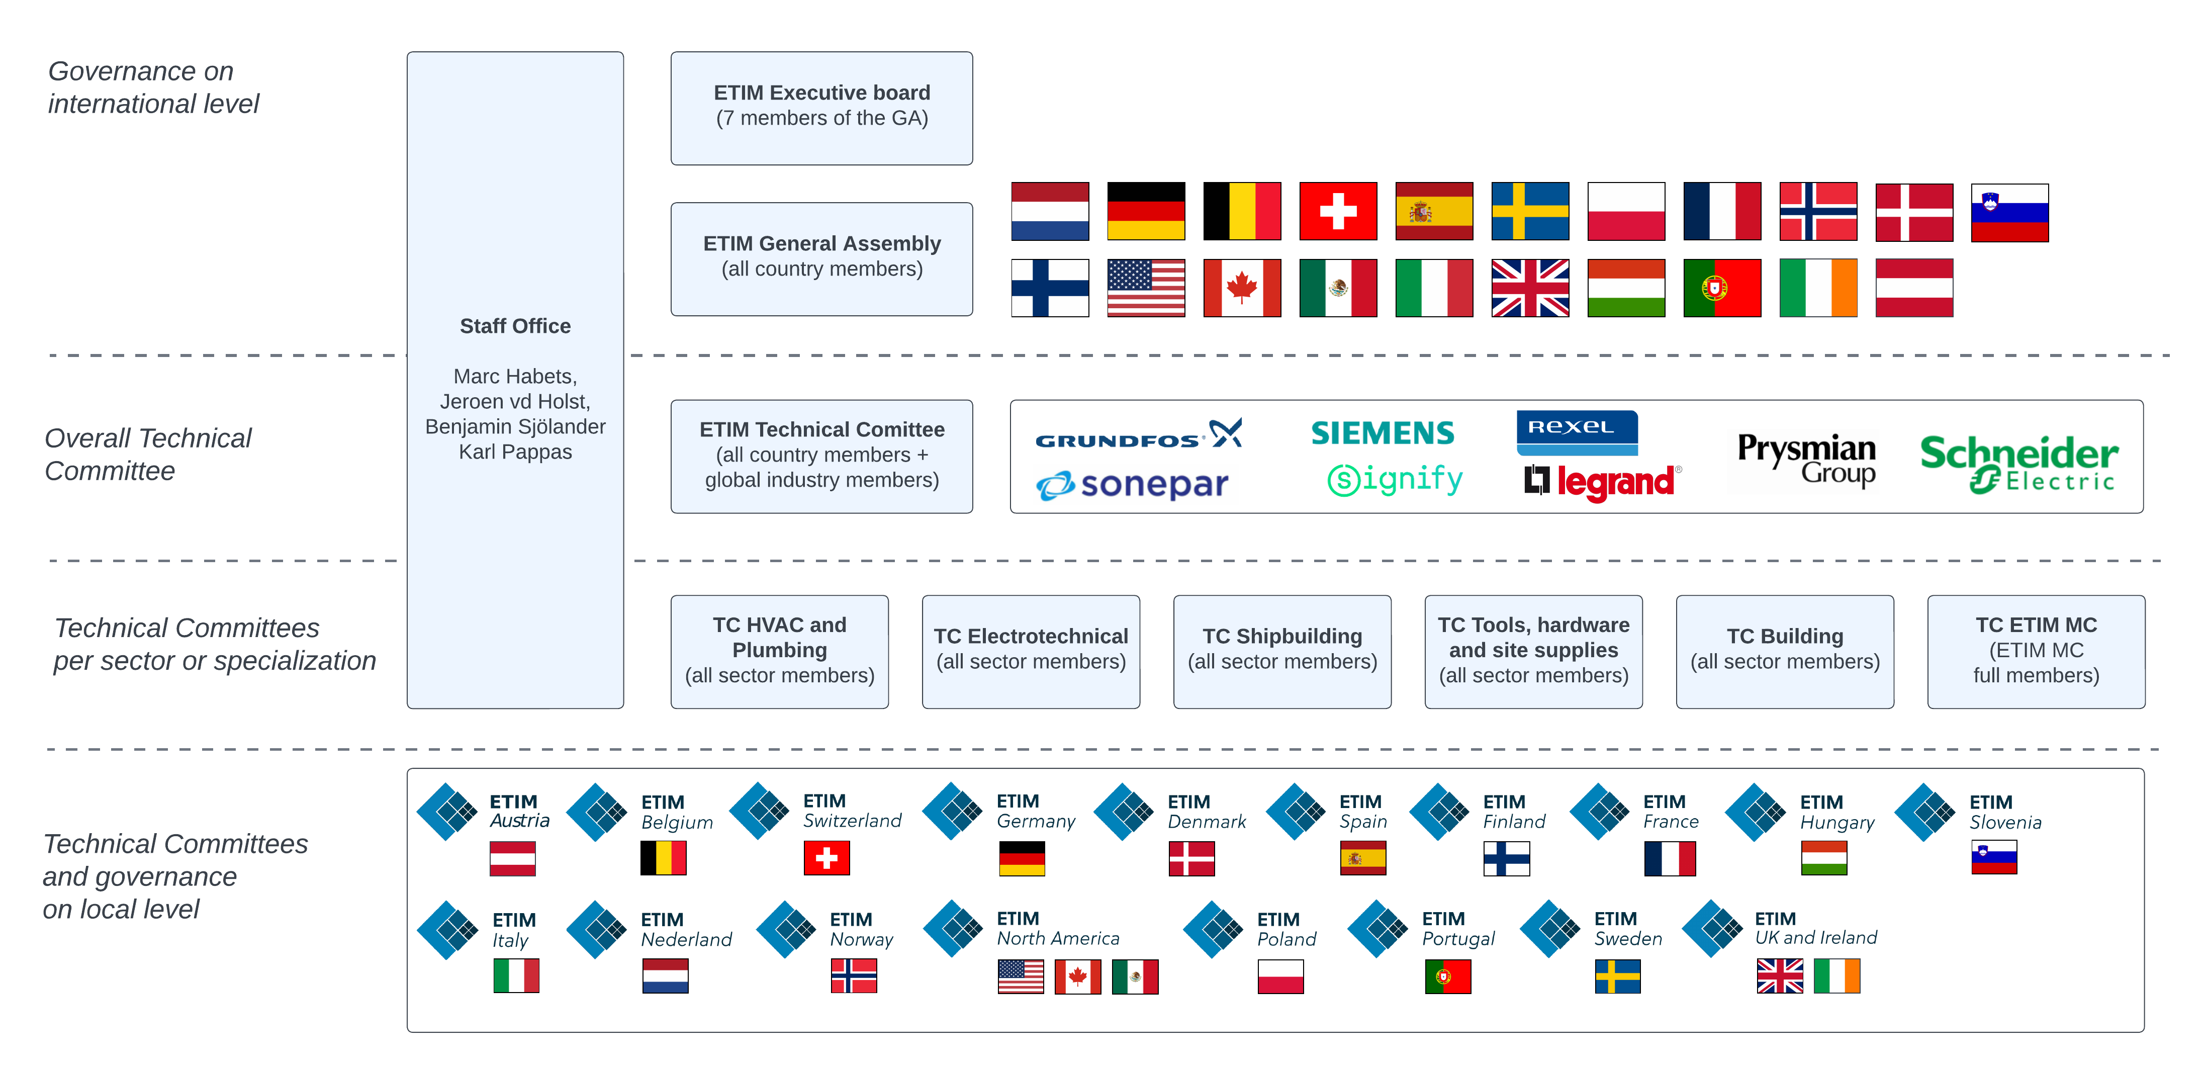
Notes:
ETIM International is an association not for profit
The chapter organisations are its members, which are mostly local industry and trade associations
The chapter organisations form the General Assembly from which 7 members are chosen in the Board
The Board interacts with the Staff Office that run the operations on international level.
The staff office validates and processes the change requests made by ETIM members from the various chapter organisations.
Besides that we organize board meetings, general assembly meetings, technical committee meetings and we organize promotional events.
There are a group of Global Industry Members who are member in several local chapter organizations but also support ETIM International directly. And therefore they also have a seat on the international Technical Committees.

Slide 35














ETIM Classification: bottom up concencus
EC000003 Residual Current Circuit Breaker (RCCB)
Agreement on Teminology, categories, descriptors, units Compliancy with technical standards.
Local Working groups define recommendations
Local companies that know their products, applicable standards, and current market trends
Notes:
ETIM standards are managed by its active users.
Supported by the industry and trade associations.
Most of the work is done at the level of local chapter organisations
ETIM standards are open to everyone, but if you wish to support it
and you would like to have influence in the development and maintenance,
you can join a chapter organization as a member.
These organisations provide support in change requests,
In translation maintenance and help to promote the adoption on a local level.
Change requests are initiated by local companies that know their products, the applicable local technical standards and current market trends
The staff office are not the experts, we only facilitate the process

Slide 36
Why adopt?

Slide 37
Benefits of using ETIM
Increased product data quality.
Significantly lower hidden costs.
Increased level of automation.
Reduction of IT-development cost.
ETIM gets your products shortlisted.
Notes:
Increased product data quality: being able to supply and use detailed technical product information reduces mistakes, increases customer satisfaction, increases quality of buildings and their HVAC and Electrical systems, optimizes business processes.
Hidden costs: ask any business how much turnover is credited at the end of the month due to return-sending because of miscommunication. How much time is spend by customer service to right all these wrongs? How much calls and enquiries are coming in because the info is not on your website, or on your distributor’s website? What if you can keep half of that turnover at the end of each month?
Increased level of automation means that your staff can shift their attention to finding new customers instead of trying to hold on to existing ones.
Reduction of IT-development cost: by using standard structured data, you can use off- the – shelve IT systems instead of custom IT-development.
And the next step is to integrate the entire supply chain into building designs by populating bim objects with all this product data, linked to data pools.

Slide 38
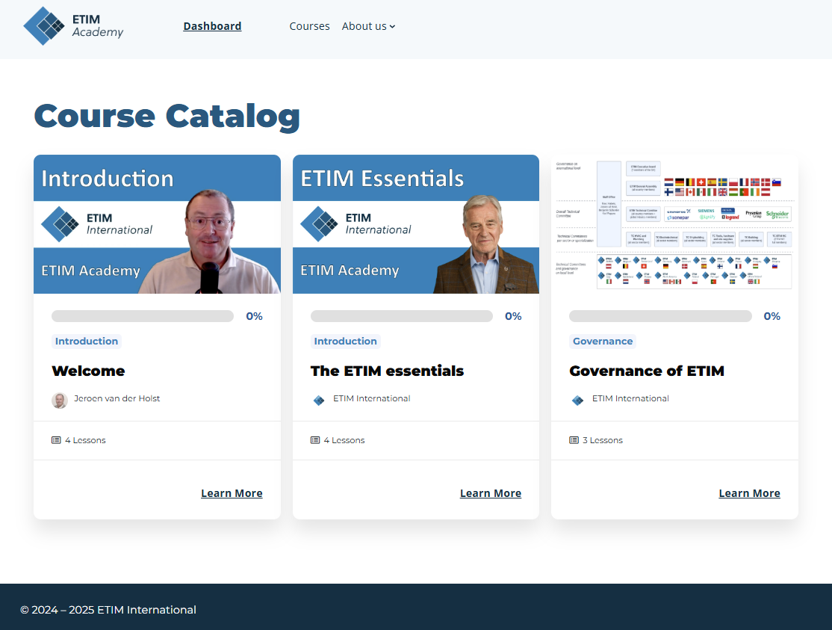
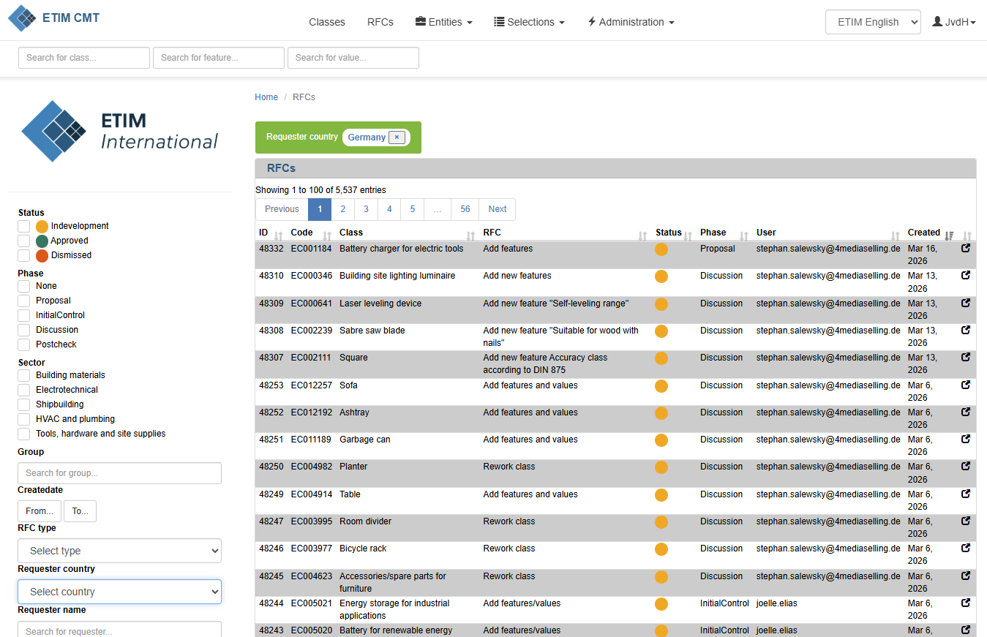
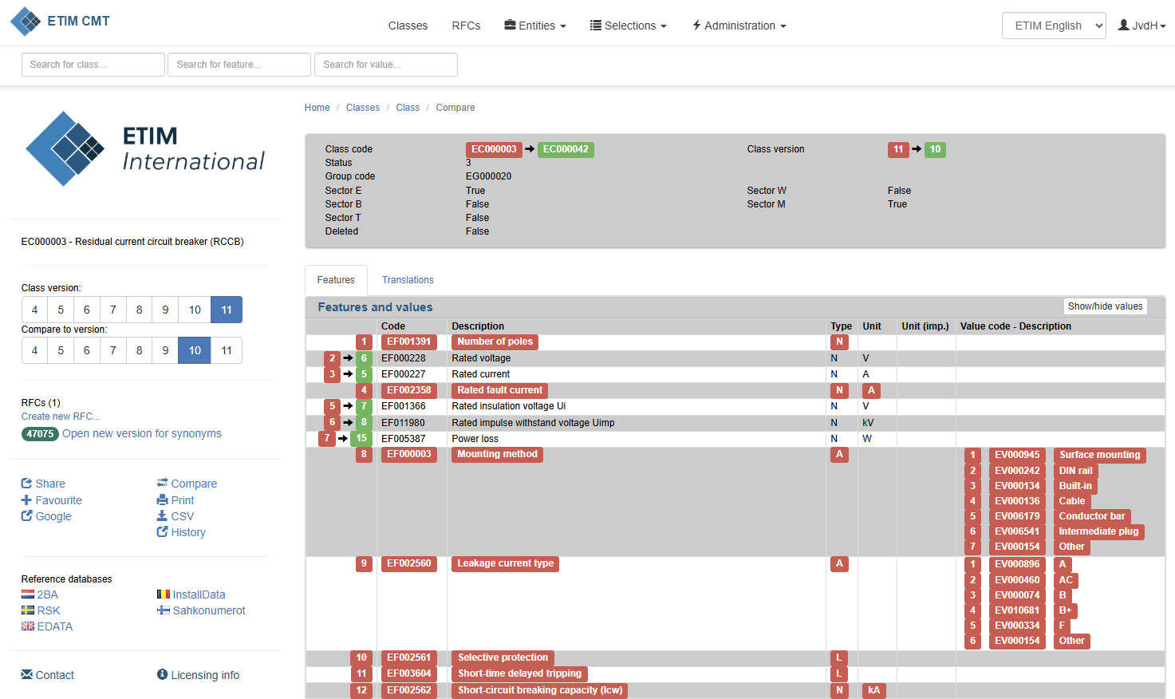
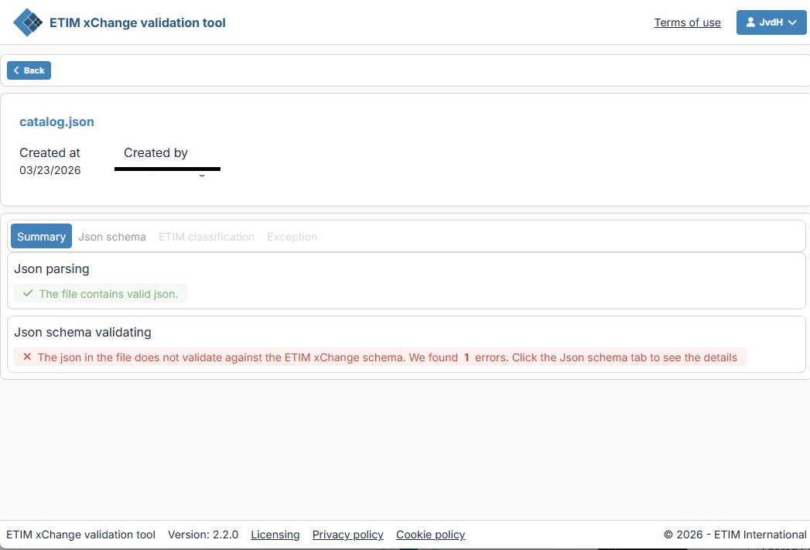
Join the ETIM Community
As a member:
You can request changes to the classification system
You get access to:
Classification management tool
ETIM Academy
Data exchange file validation services
Support from your local ETIM organization.
You help support the standard
Notes:
Standards thrive on adoption.
We strongly believe in being an open standard for everyone to use.
But open standards need management, maintenance and development
They need active users who participate
and our operations need a budget.
For a relatively small contribution you can make a large impact to your business and the environment
And in return you can become part of the ETIM Community, which gives you access to (click)
Sending in change requests (click)
Extended functionalities in our classification management tools (click)
The ETIM academy that is about to launch in April (click)
Tools to test and validate your product data files (click)
Support from your local ETIM chapter
But most important is that you help to support the ETIM Standards for your own benefits

Slide 39
Notes:
Thank you for your attention so far. Are there any questions?
(answer questions from the chat)
I hope you don’t mind that we will ask for your feedback
I would really like to know what topics you think we should cover in our next webinar.

Slide 40
Extra content
https://www.youtube.com/@etiminternational
https://academy.etim-international.com
https://www.etim-international.com

Slide 41


Slide 42


